Slide 1
Network Classes and Subnetting,
Troubleshooting
Department of Computer Science and Applications,
MITWPU, Pune
Prepared by:
Dr. Suvarna Sharma

Slide 2
Index
1. IP Address
2. Classful Addressing
3. Hierarchy of IPv4 Addresses
4. Network Classes (A,B,C,D,E)
5. Subnetting
2

Slide 3
IPv4 Address
An IP address is a unique global address for a network interface
Exceptions:
Dynamically assigned IP addresses
IP addresses in private networks
An IP address:
- is a 32 bit long identifier
- encodes a network number (network prefix) and a host number
3

Slide 4
Network Prefix and host number
The network prefix identifies a network and the host number identifies a specific host (actually, interface on the network).
How do we know how long the network prefix is?
– Before 1993: The network prefix is implicitly defined (see class-based addressing)
or
– After 1993: The network prefix is indicated by a netmask.
network prefix | host number
4

Slide 5
IPv4 ADDRESSES
An IPv4 address is a 32-bit address that uniquely and universally defines the connection of a device (for example, a computer or a router) to the Internet.
Each computer in a TCP/IP network must be given a unique identifier, or IP address.
This address, which operates at Layer 3, allows one computer to locate another computer on a network.
An address space is the total number of addresses used by the protocol.
The address space of IPv4 is 2³² or 4,294,967,296 (more than 4 billion).
If a device operating at the network layer has m connections to the internet, it needs to have m addresses. E.g.: router
Computer Networks
5

Slide 6
Dotted Decimal Notation
IP addresses are written in a so-called dotted decimal notation
Each byte is identified by a decimal number in the range [0..255]:
Example
1st Byte 2nd Byte 3rd Byte 4th Byte
= 128 = 143 = 137 = 144
128.143.137.144
10000000 | 10001111 | 10001001 | 10010000
6

Slide 7
Example
Change the following IPv4 addresses from dotted-decimal notation to binary notation.
Solution
We replace each decimal number with its binary equivalent.
Computer Networks
7

Slide 8
Classful Addressing
An IP address is 32-bit long. An IP address is divided into sub-classes:
Class A
Class B
Class C
Class D
Class E
An IP address is divided into two parts:
Network ID: It represents the number of networks.
Host ID: It represents the number of hosts.
Computer Networks
8

Slide 9
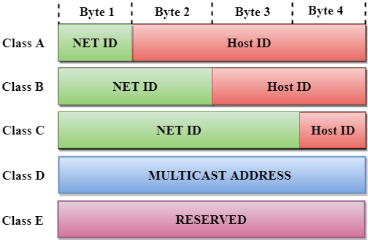
In the diagram, we observe that each class have a specific range of IP addresses. The class of IP address is used to determine the number of bits used in a class and number of networks and hosts available in the class.
Classful Addressing (contd.)
Figure 3: Classful Addressing
9

Slide 10
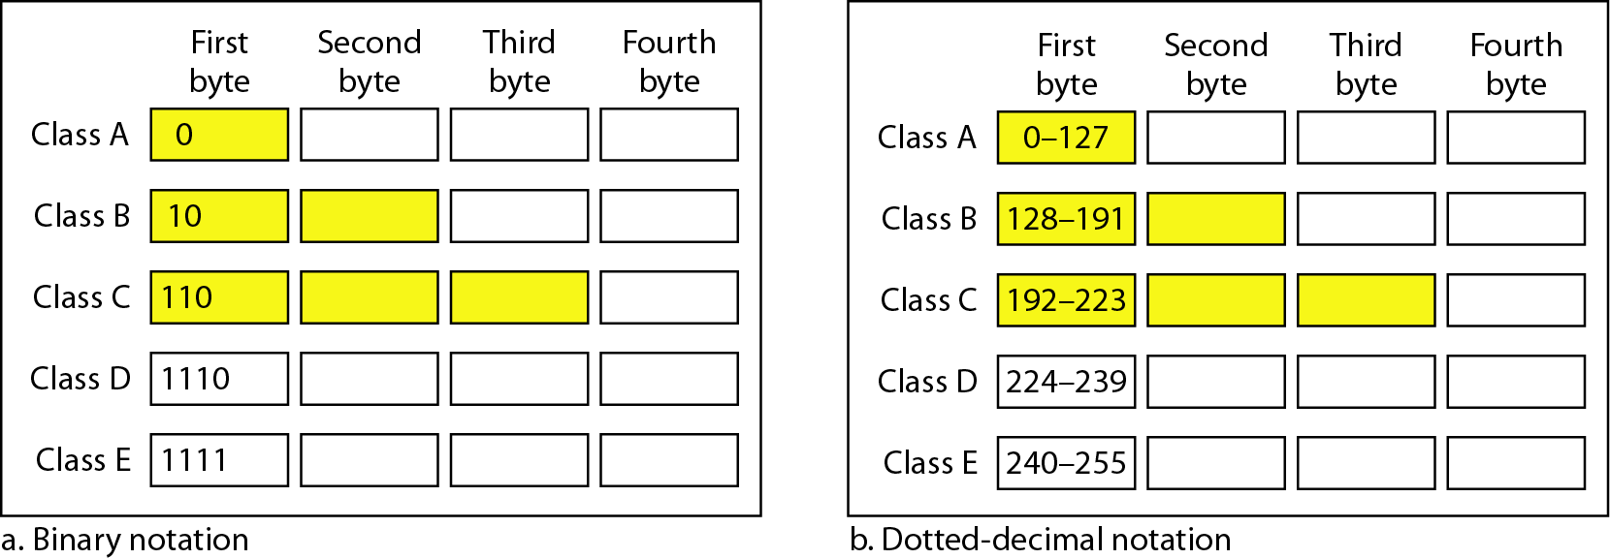
Classful Addressing (contd.)
Figure 4: Finding the classes in binary and dotted-decimal notation
Computer Networks
10

Slide 11
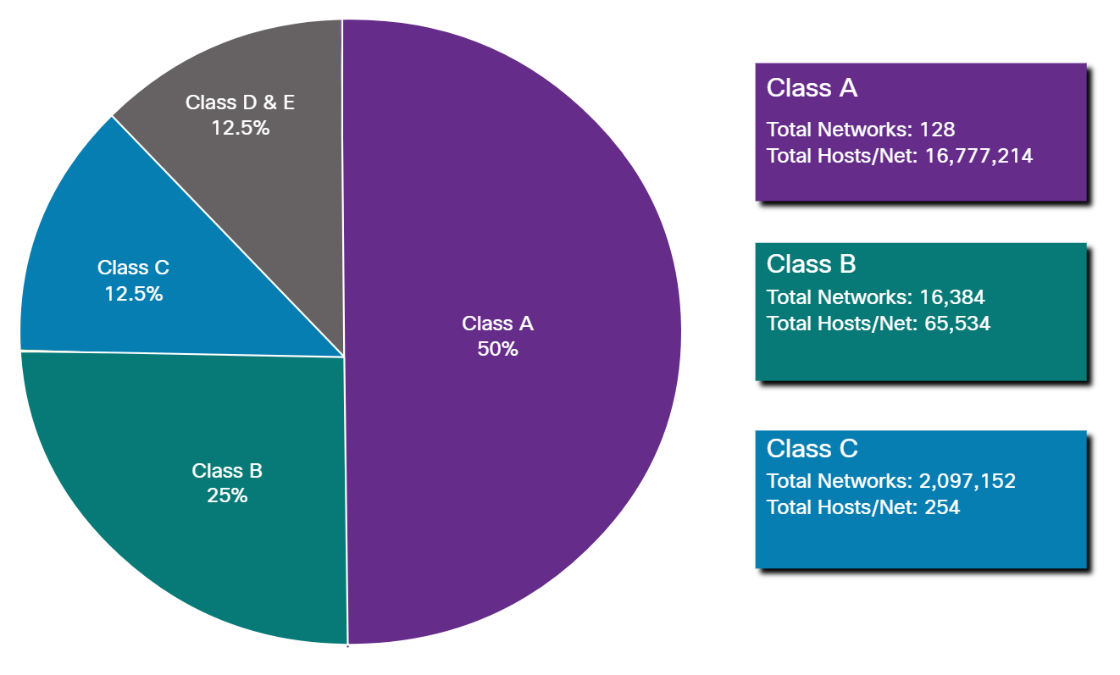
Classful Addressing (contd.)
Figure 5: Networks and Hosts in classes

Slide 12

Class A
In Class A, an IP address is assigned to those networks that contain a large number of hosts.
The network ID is 8 bits long.
The host ID is 24 bits long.
In Class A, the first bit in higher order bits of the first octet is always set to 0 and the remaining 7 bits determine the network ID. The 24 bits determine the host ID in any network.
The total number of networks in Class A = 2⁷ = 128 network address
The total number of hosts in Class A = 2²⁴ - 2 = 16,777,214 host address
Computer Networks
12

Slide 13
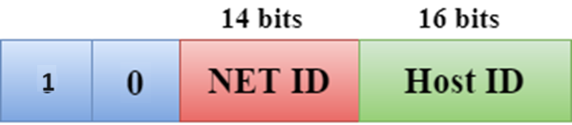
Class B
In Class B, an IP address is assigned to those networks that range from small-sized to large-sized networks.
The Network ID is 16 bits long.
The Host ID is 16 bits long.
In Class B, the higher order bits of the first octet is always set to 10, and the remaining14 bits determine the network ID. The other 16 bits determine the Host ID.
The total number of networks in Class B = 2¹⁴ = 16384 network address
The total number of hosts in Class B = 2¹⁶ - 2 = 65534 host address
13

Slide 14

Class C
In Class C, an IP address is assigned to only small-sized networks.
The Network ID is 24 bits long.
The host ID is 8 bits long.
In Class C, the higher order bits of the first octet is always set to 110, and the remaining 21 bits determine the network ID. The 8 bits of the host ID determine the host in a network.
The total number of networks = 2²¹ = 2097152 network address
The total number of hosts = 2⁸ - 2 = 254 host address
14

Slide 15

Class D
In Class D, an IP address is reserved for multicast addresses. It does not possess subnetting.
The higher order bits of the first octet is always set to 1110, and the remaining bits determines the host ID in any network.
15

Slide 16

Class E
In Class E, an IP address is used for the future use or for the research and development purposes. It does not possess any subnetting. The higher order bits of the first octet is always set to 1111, and the remaining bits determines the host ID in any network.
16

Slide 17
Classful Addressing
A block in class A address is too large for almost any organization. It means that most of the IP addresses in class A were wasted.
A block in class B is also very large.
A block in class C is probably too small for many organizations.
Class D addresses were designed for multicasting. Each IP address in this class is used to define one group of hosts on the Internet. The Internet authorities wrongly predicted a need of 268,435,456 groups. This never happened and many IP addresses were wasted.
Class E IP addresses were reserved for future use; only a few were used, resulting in another waste of IP addresses
17

Slide 18
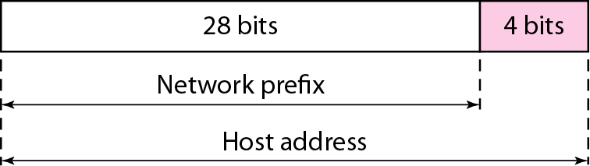
Two level hierarchy in an IPv4 address
Leftmost n bits (prefix) define the network id and,
The right most 32-n (suffix) bits define the host id.
The prefix is common to all devices in the network, suffix changes from one device to another.
18

Slide 19
Netid and Hostid:
This concept does not apply to class D and E.
For class A, one byte defines netid, and three bytes define hostid.
In class B, two bytes define the netid, and two bytes define the hostid.
In class C, three bytes define the netid , and one byte defines the hostid.
19

Slide 20
Network Masks
Mask:
The concept does not apply to classes D and E.
The mask can help us find netid and hostid.
The last column shows the mask in the form /n, where n can be 8,16, or 24. This notation is called slash notation or Classless Interdomain Routing (CIDR) notation.
Figure 6: Default masks for classful addressing
Computer Networks
20

Slide 21
Network Masks (Contd.)
An IP address on a Class A network that has not been subnetted would have an address/mask pair similar to: 10.20.15.1 255.0.0.0.
In order to see how the mask helps you identify the network and node parts of the address, convert the address and mask to binary numbers.
10.20.15.1 = 00001010.00010100.00001111.00000001
255.0.0.0 = 11111111.00000000.00000000.00000000
Once you have the address and the mask represented in binary, then identification of the network and host ID is easier. Any address bits which have corresponding mask bits set to 1 represent the network ID. Any address bits that have corresponding mask bits set to 0 represent the node ID.
10.20.15.1 = 00001010.00010100.00001111.00000001
255.0.0.0 = 11111111.00000000.00000000.00000000
--------------------------------------------------
net id | host id
netid = 00001010 = 10
hostid = 00010100.00001111.00000001 = 20.15.1
21

Slide 22
Rules for assigning Host ID:
The Host ID is used to determine the host within any network. The Host ID is assigned based on the following rules:
The Host ID must be unique within any network.
The Host ID in which all the bits are set to 0 cannot be assigned as it is used to represent the network ID of the IP address.
The Host ID in which all the bits are set to 1 cannot be assigned as it is reserved for the multicast address.
22

Slide 23
Rules for assigning Network ID:
If the hosts are located within the same local network, then they are assigned with the same network ID. The following are the rules for assigning Network ID:
The network ID cannot start with 127 as 127 is used by Class A.
The Network ID in which all the bits are set to 0 cannot be assigned as it is used to specify a particular host on the local network.
The Network ID in which all the bits are set to 1 cannot be assigned as it is reserved for the multicast address.
23

Slide 24
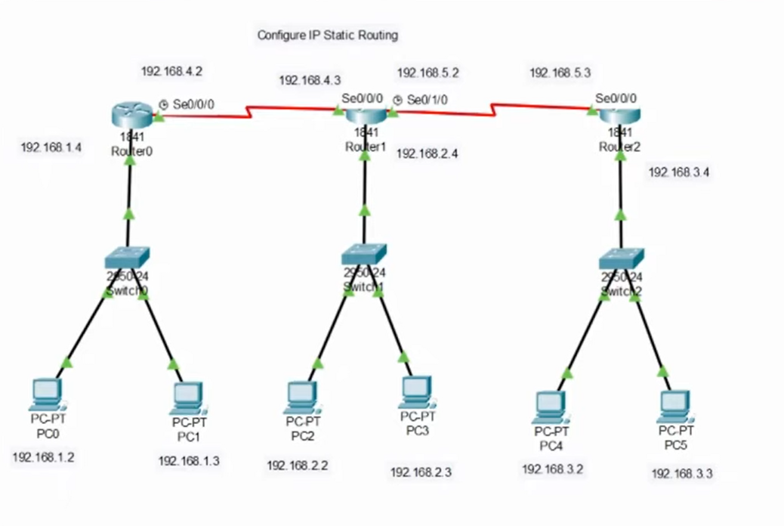

Slide 25
Classful Addressing Chart
Figure 7: Number of blocks and block size in classful IPv4 addressing
25

Slide 26
Classful Addressing Chart
Class | Higher bits | NET ID bits | HOST ID bits | No. of networks | No. of hosts per network | Range
A | 0 | 8 | 24 | 2⁷ | 2²⁴ | 0.0.0.0 to 127.255.255.255
B | 10 | 16 | 16 | 2¹⁴ | 2¹⁶ | 128.0.0.0 to 191.255.255.255
C | 110 | 24 | 8 | 2²¹ | 2⁸ | 192.0.0.0 to 223.255.255.255
D | 1110 | Not defined | Not defined | Not defined | Not defined | 224.0.0.0 to 239.255.255.255
E | 1111 | Not defined | Not defined | Not defined | Not defined | 240.0.0.0 to 255.255.255.255
26

Slide 27
Classless Addressing
Classless Addressing is one of the IP(Internet Protocol) address classifications. IP addresses are unique and universal. No two hosts will simultaneously have the same IP address in the world. The most common use of the classless addressing system Or Classless interdomain routing (CIDR) for actually addressing is to combine two or more class C networks to create a /23 or /22 Supernet.
To overcome address depletion and give Internet access to more organizations, classless addressing was designed and implemented.
In this scheme, there are no classes but the addresses are still granted in blocks.
Number of Addresses in a Block
There is only one condition on the number of addresses in a block; it must be a power of 2 (2, 4, 8, ...).
A household may be given a block of 2 addresses.
A small business may be given 16 addresses.
A large organization may be given 1024 addresses.
27

Slide 28
Classless Addressing (Contd.)
Beginning Address
The beginning address must be evenly divisible by the number of addresses.
For example, if a block contains 4 addresses, the beginning address must be divisible by 4.
If the block has less than 256 addresses, we need to check only the rightmost byte.
If it has less than 65,536 addresses, we need to check only the two rightmost bytes, and so on.
Computer Networks
28

Slide 29
Examples
Which of the following can be the beginning address of a block that contains 16 addresses?
205.16.37.32
190.16.42.44
17.17.33.80
123.45.24.52
16 = 2⁴ → last 4 bits = 0
Last 4 bits are part of the last octet
So we check: Is the last octet divisible by 16?
That’s why we divide by 16
Solution
The address 205.16.37.32 is eligible because 32 is divisible by16.
The address 17.17.33.80 is eligible because 80 is divisible by 16.

Slide 30
Examples
Which of the following can be the beginning address of a block that contains 1024 addresses?
205.16.37.32
190.16.42.0
17.17.32.0
123.45.24.52
Solution
A block of 1024 addresses = 2¹⁰, so the starting (beginning) address must have its last 10 bits = 0.
This means:
The block size is 1024 → subnet mask is /22 (since 32 − 10 = 22)
Valid starting addresses must be multiples of 1024 in terms of address numbering
Quick rule:
Look at the last two octets
Since 1024 = 4 × 256, the third octet must be a multiple of 4, and the fourth octet must be 0

Slide 31
Subnetting
If an organization was granted a large block in class A or B, it could divide the addresses into several contiguous groups and assign each group to smaller networks (called subnets).
Subnetting increases the number of 1s in the mask.
31

Slide 32
Supernetting
The size of a class C block with a maximum number of 256 addresses did not satisfy the needs of most organizations.
In supernetting, an organization can combine several class C blocks to create a larger range of addresses.
In other words, several networks are combined to create a super network or supernet.
E.g. an organization that needs 1000 addresses can be granted four contiguous class C blocks.
Supernetting decreases the number of 1s in the mask.
E.g. if an organization is given four class C blocks, the mask changes from /24 to /22.
Classless addressing eliminated the need for supernetting.
32

Slide 33
Example
Figure (on next slide) shows a block of addresses, in both binary and dotted-decimal notation, granted to a small business that needs 16 addresses.
We can see that the restrictions are applied to this block. The addresses are contiguous.
The number of addresses is a power of 2 (16 = 2⁴), and the first address is divisible by 16.
The first address, when converted to a decimal number, is 3,440,387,360, which when divided by 16 results in 215,024,210.
Computer Networks
33

Slide 34
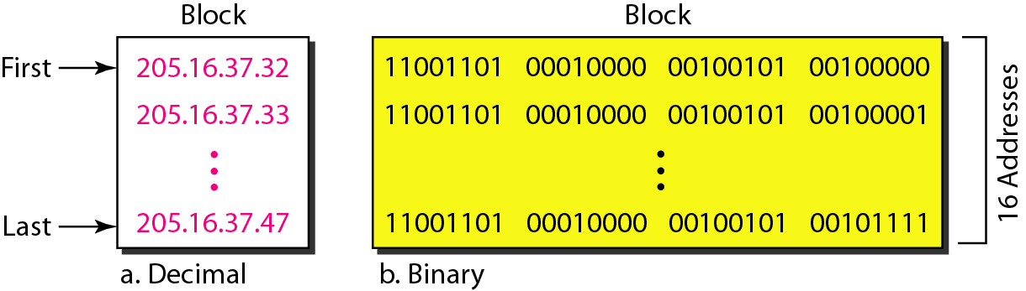
Example (contd.)
Figure 8: A block of 16 addresses granted to a small organization
34

Slide 35
In IPv4 addressing, a block of addresses can be defined as
x.y.z.t /n
in which x.y.z.t defines one of the addresses and the /n defines the mask.
35

Slide 36
The first address in the block can be found by setting the rightmost 32 − n bits to 0s.
36

Slide 37
Example
A block of addresses is granted to a small organization. We know that one of the addresses is 205.16.37.39/28. What is the first address in the block?
37

Slide 38
Example
Solution:
The block of addresses 205.16.37.39/28 represents a subnet with a subnet mask of 28 bits.
To determine the first, we need to convert the subnet mask to its binary representation and perform some calculations.
The subnet mask 28 means that the first 28 bits of the IP address represent the network portion, and the remaining 4 bits are available for host addresses.
Converting the subnet mask 28 to binary results in 32 bits with the first 28 bits set to 1 and the last 4 bits set to 0:
11111111.11111111.11111111.11110000
To calculate the first address, we perform a logical AND operation between the given address (205.16.37.39) and the subnet mask:
Address: 11001101.00010000.00100101.00100111
Subnet Mask: 11111111.11111111.11111111.11110000
AND Operation: 11001101.00010000.00100101.00100000
The result of the AND operation gives us the network address, which is 205.16.37.32.
Therefore, the first address in the block is 205.16.37.32.
38

Slide 39
Network Address:
The first address is called the network address and defines the organization network
First address is used as the network address that represents the organization to the rest of the world.
Computer Networks
39

Slide 40
The last address in the block can be found by setting the rightmost 32 - n bits to 1s.
Computer Networks
40

Slide 41
Example
A block of addresses is granted to a small organization. We know that one of the addresses is 205.16.37.39/28. What is the last address in the block?
Computer Networks
41

Slide 42
Example
205.16.37.39/28
Solution:
To calculate the last address, we need to find the highest possible host address within the block. Since we have 4 bits available for host addresses (2^4 = 16), the highest host address is obtained by setting all 4 bits to 1:
Address: 11001101.00010000.00100101.00100111
Subnet Mask: 11111111.11111111.11111111.11110000
Subnet Mask Complement: 00000000.00000000.00000000.00001111
11001101.00010000.00100101.00100111
00000000.00000000.00000000.00001111
OR Operation: 11001101.00010000.00100101.00101111
The result of the OR operation, with the complement of the mask, gives us the broadcast address, which is 205.16.37.47. However, the last address in the block is always reserved as the broadcast address, so the actual last usable address is the one before the broadcast address. Therefore, the last address in the block is 205.16.37.46.
Computer Networks
42

Slide 43
The number of addresses in the block can be found by using the formula 2^{32-n}.
Computer Networks
43

Slide 44
Three level of Hierarchy: subnetting
An organization that is granted a large block of addresses may want to create clusters of networks (subnets) and divide the addresses between the different subnets.
The rest of the world still sees the organization as one entity; however internally there are several subnets.
All messages are sent to the router that connects the organization to the rest of the Internet; the router routes the message to the appropriate subnets.
The organization has its own mask and each subnet must also have its own.
Computer Networks
44

Slide 45
Example
Suppose an organization is given the block 17.12.40.0/26, which contains 64 IP addresses. The organization has three offices and needs to divide the addresses into three subblocks of 32,16, and 16 IP addresses.
We can find the new masks as
Suppose the mask for the first subnet is n₁ then 2^{32-n1} must be 32, which means n₁=27.
Suppose the mask for the second subnet is n₂ then 2^{32-n2} must be 16, which means n₁=28.
Suppose the mask for the third subnet is n₃ then 2^{32-n3} must be 16, which means n₁=28.
Computer Networks
45

Slide 46
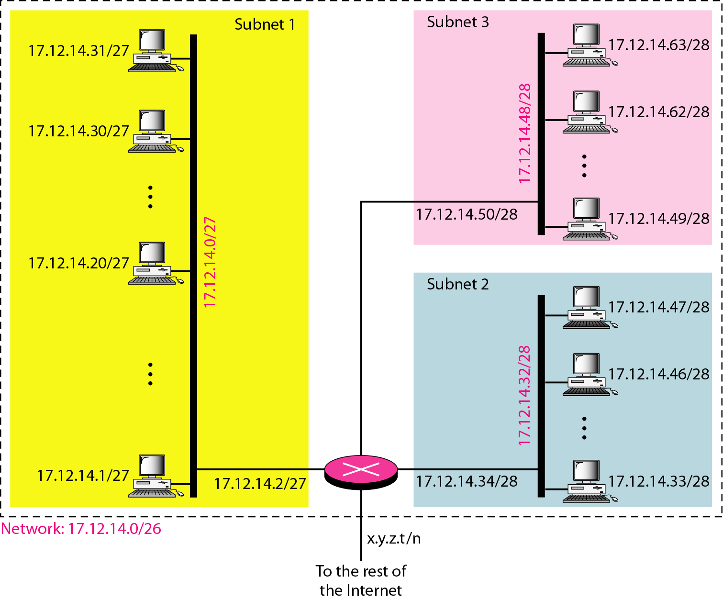
Example (contd.)
Figure 9: Configuration and addresses in a subnetted network
46

Slide 47
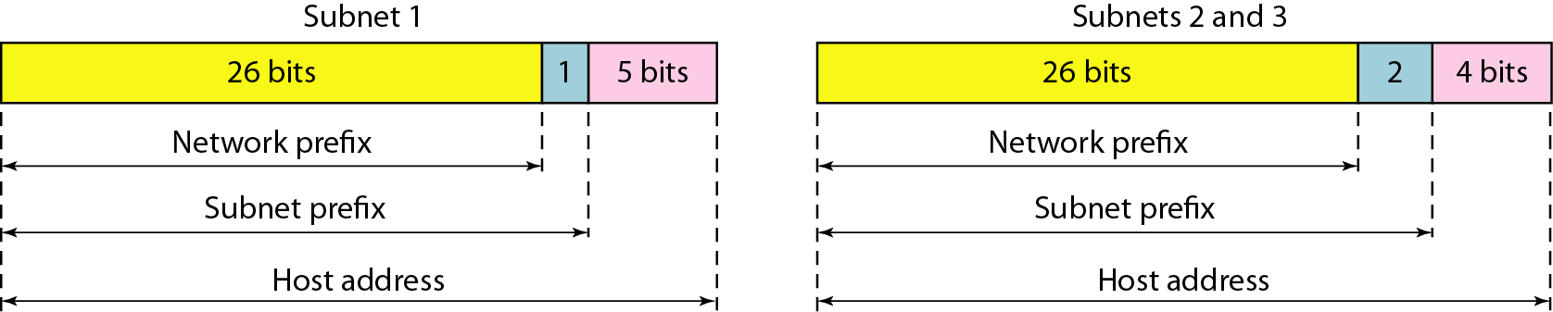
Three-level hierarchy in an
IPv4 address
Figure 10: Three-level hierarchy in an IPv4 address
Computer Networks
47

Slide 48
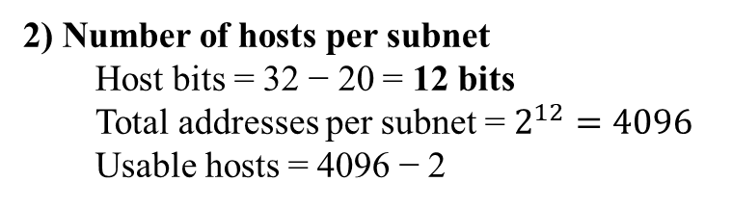
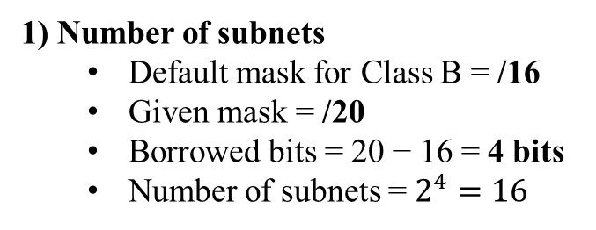
Example
Given IP address 182.168.1.0/20, calculate: • Number of subnets • Number of hosts per subnet • Valid host range for the first subnet
1) Number of subnets
Default mask for Class B = /16
Given mask = /20
Borrowed bits = 20 − 16 = 4 bits
Number of subnets = $2^{4}=16$
2) Number of hosts per subnet
Host bits = 32 − 20 = 12 bits
Total addresses per subnet = $2^{12}=4096$ Usable hosts = 4096 − 2
3) Valid host range for the first subnet
Block size = 16 in the third octet (because /20)
Subnets start from:
182.168.0.0
182.168.16.0
182.168.32.0 …
First subnet:
Network address: 182.168.0.0
Broadcast address: 182.168.15.255
Valid host range: 182.168.0.1 to 182.168.15.254

Slide 49
Example
Given IP address 192.16.0.0/26, calculate: • Number of subnets • Number of hosts per subnet • Subnet mask in dotted decimal form
Default Class of Address: Class C subnet mask 24 bits
Number of subnets
bits in subnet mask 26
Borrowed bits = 26 − 24 = 2
Number of subnets = 2² = 4
Number of hosts per subnet
Host bits = 32 − 26 = 6
Total hosts = 2⁶ = 64
Usable hosts = 64 − 2 = 62
Subnet mask in dotted decimal form
11111111.11111111.11111111.11000000
Subnet mask = 255.255.255.192

Slide 50
Example
An ISP is granted a block of addresses starting with 190.100.0.0/16 (65,536 addresses). The ISP needs to distribute these addresses to three groups of customers as follows:
a. The first group has 64 customers; each needs 256 addresses.
b. The second group has 128 customers; each needs 128 addresses.
c. The third group has 128 customers; each needs 64 addresses.
Design the subblocks and find out how many addresses are still available after these allocations.
50

Slide 51
Example (contd.)
Solution
Group 1
For this group, each customer needs 256 addresses. This means that 8 (log₂ 256) bits are needed to define each host. The prefix length is then 32 − 8 = 24. The addresses are
51

Slide 52
Example (contd.)
Group 2
For this group, each customer needs 128 addresses. This means that 7 (log₂ 128) bits are needed to define each host. The prefix length is then 32 − 7 = 25. The addresses are
52

Slide 53
Example (contd.)
Group 3
For this group, each customer needs 64 addresses. This means that 6 (log₂64) bits are needed to each host. The prefix length is then 32 − 6 = 26. The addresses are
Number of granted addresses to the ISP: 65,536
Number of allocated addresses by the ISP: 40,960
Number of available addresses: 24,576
53

Slide 54
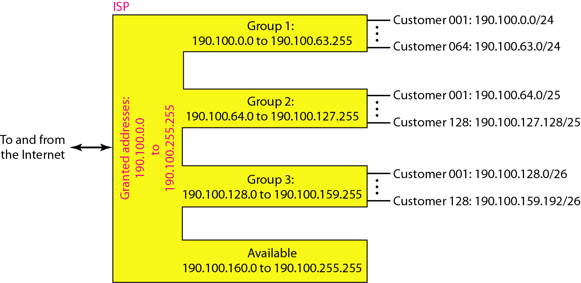
Example (contd.)
Figure 11: An example of address allocation and distribution by an ISP
54

Slide 55
Practice Questions
Change the following IPv4 addresses from binary notation to dotted-decimal notation.
55

Slide 56
Practice Questions
Find the error, if any, in the following IPv4 addresses.
56

Slide 57
Practice Questions
Find the class of each address.
a. 00000001 00001011 00001011 11101111
b. 11000001 10000011 00011011 11111111
c. 14.23.120.8
d. 252.5.15.111
Find the class of each address.
a. 00000001 00001011 00001011 11101111
b. 11000001 10000011 00011011 11111111
c. 14.23.120.8
d. 252.5.15.111
57

Slide 58
Practice Questions
An organization is facing IP address exhaustion and plans to redesign its network.
For the Given IP address: 180.16.37.39/20, calculate:
Address Mask
First address of the block
Last address of the block
Number of addresses in the block
58

Slide 59
Practice Questions
The block of addresses 205.16.37.39/28 represents a subnet with a subnet mask of 28 bits.
To determine the first and last addresses in the block, we need to convert the subnet mask to its binary representation and perform some calculations.
The subnet mask 28 means that the first 28 bits of the IP address represent the network portion, and the remaining 4 bits are available for host addresses.
Converting the subnet mask 28 to binary results in 32 bits with the first 28 bits set to 1 and the last 4 bits set to 0:
11111111.11111111.11111111.11110000
To calculate the first address, we perform a logical AND operation between the given address (205.16.37.39) and the subnet mask:
Address: 11001101.00010000.00100101.00100111
Subnet Mask: 11111111.11111111.11111111.11110000
AND Operation: 11001101.00010000.00100101.00100000
The result of the AND operation gives us the network address, which is 205.16.37.32. Therefore, the first address in the block is 205.16.37.32.
59

Slide 60
Practice Questions
To calculate the last address, we need to find the highest possible host address within the block.
Since we have 4 bits available for host addresses (2^4 = 16), the highest host address is obtained by setting all 4 bits to 1:
Address: 11001101.00010000.00100101.00100111
Subnet Mask: 00000000.00000000.00000000.00001111
OR Operation: 11001101.00010000.00100101.00101111
The result of the OR operation gives us the broadcast address, which is 205.16.37.47. However, the last address in the block is always reserved as the broadcast address, so the actual last usable address is the one before the broadcast address. Therefore, the last address in the block is 205.16.37.46.
The total number of addresses in the block can be calculated by taking the number of available host addresses, which is 2^4 = 16, and subtracting 2 (one for the network address and one for the broadcast address). Therefore, the total number of addresses in the block is 16 - 2 = 14.
60

